Slide 1
FIRE SPARKES, BANNARI AMMAN INSTITUTE OF TECHNOLOGY, TAMILNADU.
JEGADEESWARI J S, SARAVANA G, JANANI S, SHUBHA NANDHI G, NAVEENKUMAR V

Slide 2

DECARBONISATION
AND WHY DO WE URGENTLY NEED IT?

Slide 3
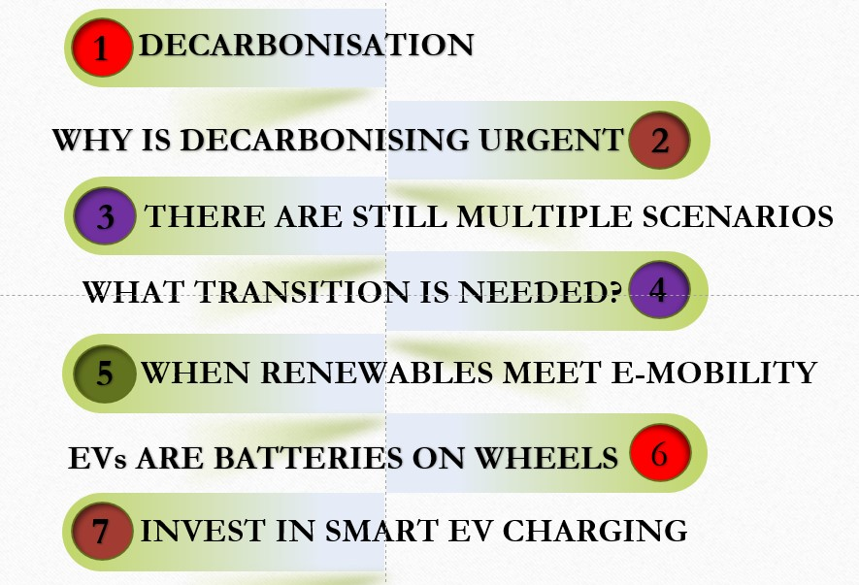
CONTENT

Slide 4
DECARBONISATION
Decarbonization (also called decarbonization across the Atlantic) refers to the process of reducing carbon dioxide (CO2) emissions caused by human activity in space. The current (and hopeful) goal of decarbonisation is, in the end, to end our carbon dioxide emissions.
In order to achieve deep decarbonisation, we need to rethink how we produce and use energy and use it to convert to renewable resources and low carbon energy sources.
In fact, reaching zero emissions requires switching to clean energy sources and moving from fossil fuels to electricity.

Slide 5
WHY IS DECARBONISING URGENT?
According to the World Economic Forum, the complete carbonization of our energy systems is the only solution to climate change. Now, we are already behind the targets set for 2015, and our current policies, in the best case scenario, could lead to an increase of 2.1 ° C and, in the worst case scenario, an increase of 3.9 ° C.
This situation is very frightening.
To give a small context, lastly the average global temperature was 2 ° C warm, the average sea level was more than 6 meters above today. With an increase of 3 ° C (current rate if we do not change our routes), cities such as Miami, Shanghai, Osaka or Rio de Janeiro will sink. In addition, a total of 275 million people worldwide will have to evacuate and escape the flood.

Slide 6
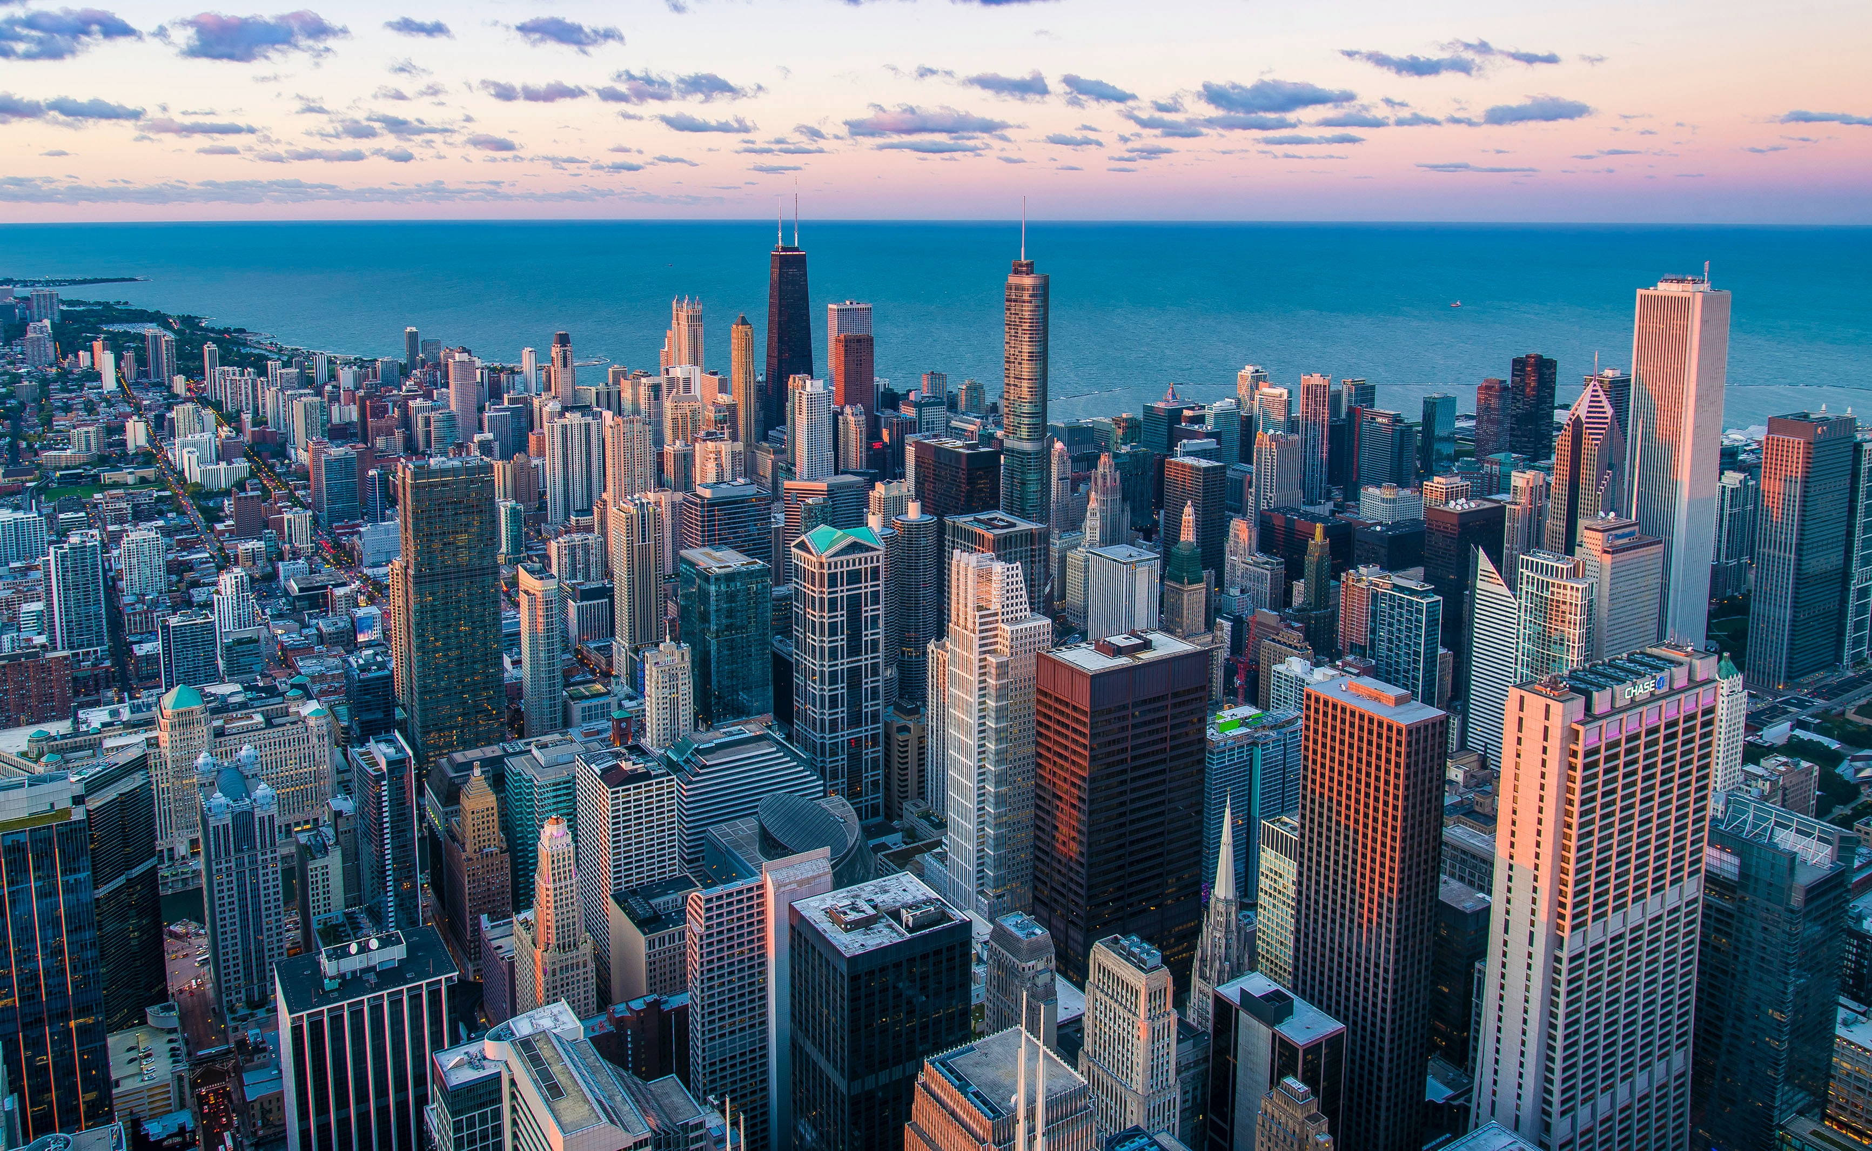

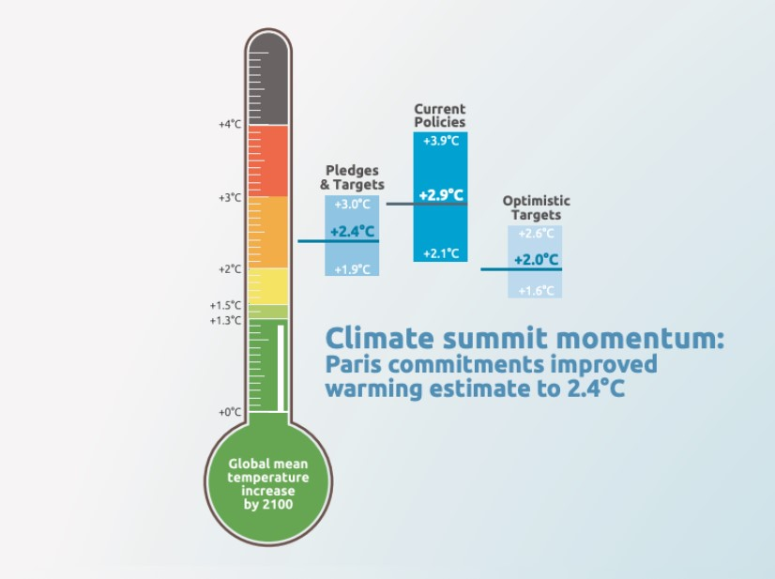
DECARBONISING URGENT:

Slide 7
THERE ARE STILL MULTIPLE SCENARIOS
The International Panel of Climate Change has generated 5 RCP (Representative Concentration Pathway) scenarios to anticipate the effects of our carbon emission on Earth’s global temperatures:
RCP8.5: This scenario depicts the likely outcome if we don’t make efforts to cut greenhouse gas emissions.
RCP6 and RCP4.5: those two scenarios describe what could happen if we cannot act fast enough. According to the latest reports, we currently sit in between scenarios 6 and 4.5.
RCP2.6: This is the only scenario where Paris Agreement goals are reached. Following this path means getting net CO₂ emissions to zero, or below zero, shortly after 2050.
While the odds don’t look great, we still have a chance to limit global warming to 2 °C (or lower) by 2100: Deep decarbonisation.

Slide 8

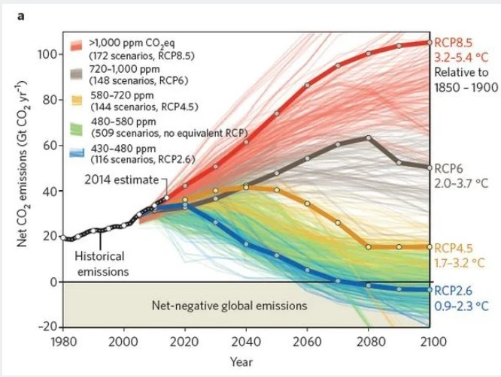
FOUR SCENARIOS FOR NET CO2 EMISSIONS

Slide 9
WHAT TRANSITION IS NEEDED?
Yes, we cannot abandon the old ways of producing and using energy overnight. But an emergency prompts us to accelerate our transformation of zero carbon emission.
The road to decarbonisation means that industries are reviving the way they produce, that we - individuals - are reviewing what we buy and put in our plates, and - and in fact it is something we at Virta can help - improve the way we produce, store and distribute. electricity.

Slide 10
WHEN RENEWABLES MEET E-MOBILITY
As we increasingly rely on renewable energy sources and low carbon emissions to power our cities, industries and vehicles, a new problem arises:
How can wind turbines generate energy when there is no air?
How can our solar panels meet the sudden energy needs of the night?
Part of the answer lies in how we store energy and return it to the grid to ensure a safe and continuous flow.

Slide 11
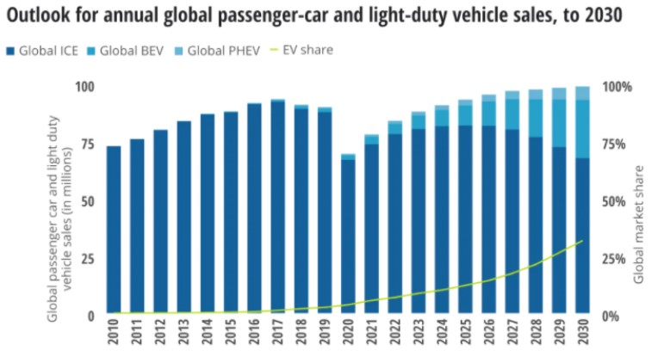
Ev’s are Batteries on wheels
It turned out that electric cars are
battery-powered. When enough cars are
connected, we can use the power and
stabilize the grid.
With the use of Smart EV charging infrastructure
and new technologies such as V2G (car to grid),
we can charge or discharge EV-connected grid
batteries based on temporary requirements,
therefore, eliminating all shortcomings.

Slide 12
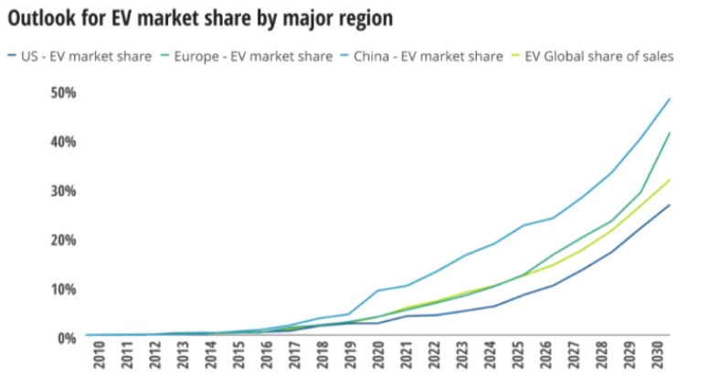
Ev’s are Batteries on wheels
Will there be enough electric vehicles to
support our energy system? Yes. By 2030,
Deloitte expects EVs to reach 32% of the total
market share of new car sales worldwide.
In Europe alone, we expect EV sales to pay
more than 40% of new car sales by 2030.
This positive prediction takes root in everything
the European Union is currently doing to meet and
violate the 2015 Paris Agreements. On July 14, 2021,
the EU unveiled a new milestone and new goals
for 2030 and beyond as part of the Green Deal.

Slide 13

NEW GOALS INCLUDE
A 55% reduction in car outages by 2030
A 50% reduction in bakkie emissions by 2030
0 release of new cars by 2035

Slide 14
INVEST IN SMART EV CHARGING
The three pillars of decarbonisation - electrical installation, electrical carbonization and energy efficiency - come together and support each other.
Yes, electronics are just one piece of the puzzle, but we need them to succeed.
We at Virta are proud to protect the future. Learn more about our Smart EV charging services and contribute to building a safe and green future through e-mobility.

Slide 15

DONE BY:
JEGADEESWARI.J.S.
SARAVANA.G.
JANANI.S.
SHUBHA NANDHINI.G.
NAVEENKUMAR.V

